Slide 1
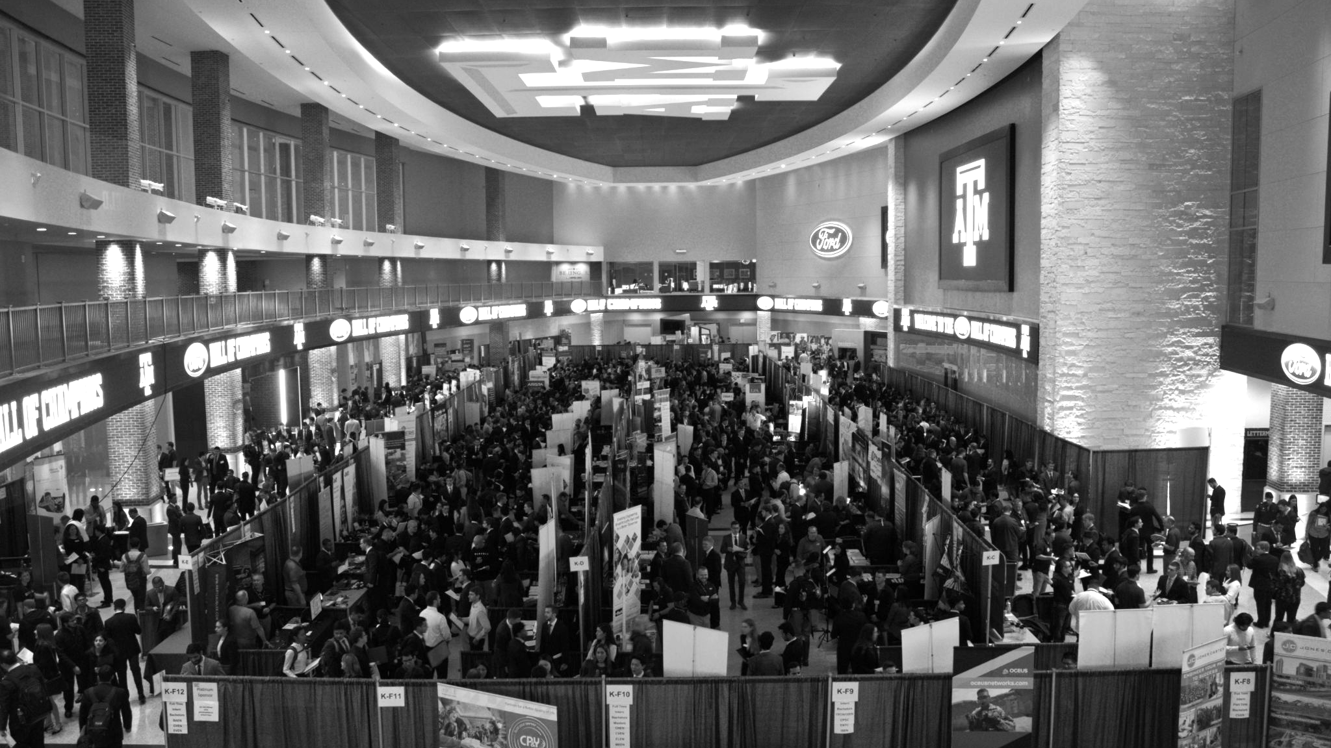

LANL Team Update
8/28/2024
Izzy Baumler, Dalton Boeckmann, Morgan Gullo, Jade Waldron

Slide 2
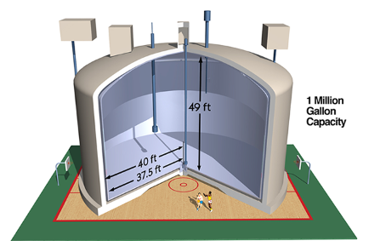
Project Context
The Hanford site in southeast Washington was created in 1943 to produce plutonium for the Manhattan Project, supplying two-thirds of the plutonium in US nuclear weapons.
Around 60 square miles of groundwater at Hanford are still contaminated above federal standards, with no active nuclear production but ongoing cleanup.
A Quadruped robot will be entering these containers to clean up and remove waste

Slide 3
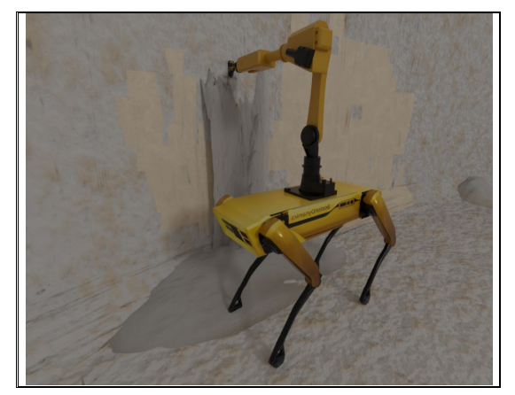
Weekly Task Updates
Created team introduction presentation
Currently reading through all research papers that sponsor provided us
Met with sponsor for one hour to gain a better knowledge of the project scope
Created task list to achieve by Friday
Set weekly meeting time for Fridays at 1 PM
Meeting with MEEN Professor Xie to get a demo of Spot Robot

Slide 4
Upcoming Week Slides
2nd Meeting with Sponsor to present our individual interest and ideas
Work with sponsor to restrict the Scope of our Project and its requirements
Collaborate as a Team to delegate roles and responsibilities due to team reorganization
Continue research about Dry Retrieval and Hanford Cleanup

